Slide 1
Section 7
Priority queues and heaps

Slide 2
Priority queues
A priority queue is a collection of zero or more elements where each element has an individual priority or value.
In a minimum priority queue, the find operation finds the element with minimum priority and the remove operation removes this element.
In a maximum priority queue, the find operation finds the element with maximum priority and the remove operation removes this element.

Slide 3
The ADT MaxPriorityQueue
AbstractDataType MaxPriorityQueue
{
instances
finite collection of elements where each element has a priority.
operations
isEmpty (): returns true if the queue is empty; returns false otherwise.
size(): returns the queue size.
getMax(): returns the element with maximum priority.
put(x): inserts the element x into the queue.
removeMax(): removes the element with largest priority and returns it.
}

Slide 4
The ADT MaxPriorityQueue
public interface MaxPriorityQueue
{
public boolean isEmpty();
public int size();
public Comparable getMax();
public Object remove(int index);
public void put(Comparable theObject);
public Comparable removeMax();
}
Lists which implement the Comparable interface can be sorted automatically by Collections.sort() and individual elements with compareTo().
Notes:
Interface Comparable<T>
T - the type of objects that this object may be compared to

Slide 5
Minimum & maximum trees
A minimum tree is a tree in which the value in each node is less than or equal to those of its children (if it has any).
A maximum tree is a tree in which the value in each node is greater than or equal to those of its children (if it has any).

Slide 6
A minimum tree example
In the tree below, the minimum element is in the root:
2
4
9
3
4
8
7
9
9

Slide 7
A maximum tree example
In the tree below, the maximum element is in the root:
9
4
9
8
4
2
7
3
1

Slide 8
Minimum & maximum heaps
Minimum & maximum heaps are minimum (& maximum) trees which are also complete binary trees.
The example below is a complete binary tree which is also a minimum tree i.e. a
minimum heap.
2
4
3
6
7
9
3
8
6
Notes:
An efficient realization of a priority queue uses a data structure called a heap.

Slide 9

Notes:
doum palm in Kenya. Photo: Charles Godfray.

Slide 10
Minimum & maximum heaps cont./
The example below is a complete binary tree which is also a maximum tree i.e. a maximum heap.
9
8
7
6
7
2
6
6
1

Slide 11
Storing heaps in an array
An array provides efficient storage for any heap.
9
8
7
6
7
2
6
5
1
heap[ ]
 | 9 | 8 | 7 | 6 | 7 | 2 | 6 | 5 | 1
1
3
5
7
9

Slide 12
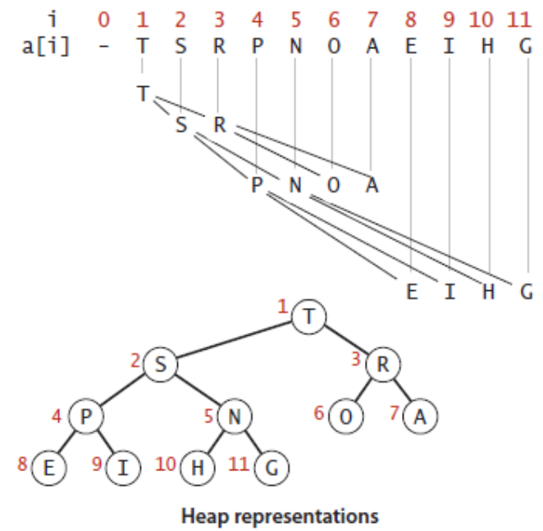
Binary heap representations
Binary heap: Array representation of a heap-ordered complete binary tree.
Heap-ordered binary tree.
Keys in nodes.
Parent’s key no smaller than children’s keys.
Array representation.
Indices start at 1.
Take nodes in level order.
No explicit links needed!

Slide 13
Binary heap properties
Largest key is a[1], which is the root of binary tree.
Can use array indices to move through tree.
Parent of node at k is at k/2.
Children of node at k are at 2k and 2k+1.
Notes:
In a heap, the parent of the node in position k is in position k/2 and , conversely, the two children of the node in position k are in positions 2k and 2k+1.
We can travel up and down by doing simple arithmetic on array indices: to move up the tree from a[k] we set k to k/2; to move down the tree we set k to 2*k or 2*k+1.

Slide 14
Moving up & down a heap
Moving from one node to another
simply involves moving from one
element of the array to the
next:
1
9
2
3
8
7
4
5
6
7
6
7
2
6
8
9
5
1

Slide 15
Inserting an element into a max heap
Insertion involves adding a new leaf node and then allowing it to "bubble/swim up" the tree until it finds a parent with priority ≥ itself. E.g. adding 12, we start with:
15
8
7
6
7
2
6
6
1
12

Slide 16
Inserting an element into a max heap cont./
Then 12 "bubbles/swims up" by swapping
with 7:
15
… and then 8:
7
15
8
12
7
6
12
2
6
6
8
2
6
6
1
7
6
1
7

Slide 17
Java code for bubble/swim up and insertion
Steps of inserting an item to PQ
Insert a new key at the end of the array
Increase the size of the heap by 1
Swim up through the heap with that key to restore the heap condition (i.e., parent node is greater or equal to its two children nodes)
public void put(Kay key) // insert a key
{ pq[++n] = key; // n is the number of keys in the PQ
swim(n);}
private void exchange(int i, int j) // swap two nodes
{ Kay t = pq[i]; pq[i] = pq[j]; pq[j] = t; }
// move up until satisfy heap condition
private void swim(int k)
{ while (k>1 && less(k/2, k))
{ exchange(k, k/2); k = k/2; }
}
private boolean less(int i, int j) // compare two keys
{ return pq[i].compareTo(pq[j]) < 0; }

Slide 18
Inserting an element into a max heap cont./
Adding another element, say 21:
15
first swap:
7
15
12
12
7
6
8
2
6
6
21
2
6
6
1
7
21
6
1
7
8

Slide 19
Inserting an element into a max heap cont./
Second swap:
15
Until finally:
7
21
21
15
7
6
12
2
6
6
12
2
6
6
1
7
8
6
1
7
8

Slide 20
Removal from a heap
Removal involves removing the max element i.e. the root. In our example, 21:
15
7
Now replace it by the larger of its two children (to preserve the complete tree structure): see next slide.
6
12
2
6
6
1
7
8

Slide 21
Removal from a heap cont./
So we now
have:
15
And then:
7
15
12
7
6
12
2
6
6
2
6
6
1
7
8
6
1
7
8

Slide 22
Removal from a heap cont./
And finally:
15
i.e.
15
12
7
12
7
6
8
2
6
6
8
2
6
6
1
7
6
1
7

Slide 23
Remove maximum key: another approach
Steps of removing the maximum by using the last item of the heap
Take the largest item off the top
put the item from the end of the heap at the top
decrease the size of the heap by 1
sink down through the heap with that key to restore the heap condition
public Key remove() // remove the largest
{ Key max = pq[1];
exchange(1, n); // swap the top item with the last item
pq[n--] = null; // avoid loitering
sink(1); return max;
}
private void sink(int k) // move down until satisfy heap condition
{ while (2*k <= n)
{ int j = 2*k;
if (j < n && less(j, j+1)) j++;
if (!less(k, j) break;
exchange(k, j); k = j; } }

Slide 24
Heapify
We define "to heapify" as "to make into a heap".
To understand how heapify works, let us consider a simple case where only one element violates the heap condition. Here it’s the root:
7
In a process similar to that of the previous removal example, the "violating" element is swapped by the larger of its two children. In this case, by 9.
8
9
6
7
2
6
6
1

Slide 25
Adjusting the heap
We call this process of element replacement "adjusting the heap".
To heapify an arbitrary complete tree, we adjust each subtree of the tree until the whole tree is a heap.
We use a method adjust(i,j) which makes a "subtree" stored from index i to index j, whose only violation is at index i, into a heap.
We start this process towards the bottom of the tree with the last element i.e. highest indexed element, that has a child. Suppose this has index i. If necessary, we "adjust" this subtree (with root at index i) and then continue adjusting (if necessary) the subtree with root i-1, and then the subtree with root i-2 and so on.
Let's consider the example on the next slide.

Slide 26
Heapify example
Here the highest indexed element with a child has index 4. This is in fact a
violation.
1
..so call adjust(4,8) which swaps 8 with 9:
3
5
1
8
6
2
7
3
5
9
9
6
2
7
8

Slide 27
Heapify example cont./
Next call adjust(3,8)
on
... which swaps 5 with 7:
1
3
5
1
9
6
2
7
3
7
8
9
6
2
5
8

Slide 28
Heapify example cont./
Next call adjust(2,8)
on
... which swaps 3 with 9 & then 3 with 8
1
3
7
1
9
6
2
5
9
7
8
8
6
2
5
3

Slide 29
Heapify example cont./
Finally, call adjust(1,8)
on
... which swaps 1 with 9 & then 1 with 8 & then 1 with 3 giving
1
9
9
7
8
7
8
6
2
5
3
6
2
5
3
1

Slide 30
Heapify cont./
So, to create a heap from scratch, we call adjust() on each node which has at least one child.
But how do we know the index of this node?
From our knowledge of how a complete BT is ordered, that index will be n/2.
Hence, we call adjust() from n/2 down to 1.
For a tree of n nodes, the method heapify() is simply
public void heapify(int n)
{
for (int i = n/2; i!=0, i--)
adjust(i, n);
}

Slide 31
Maximum binary heap: Java implementation
Public class MaxPQ<Key extends Comparable<Key>>
{
private Key[ ] pq; // ordered heap
private int n; // number of nodes [1…n]
public MaxPQ(int capacity)
{ pq = (Key[ ]) new Comparable[capacity+1]; }
public boolean isEmpty( )
{ return n == 0; }
public void put(Kay key) // insert an element
{ pq[++n] = key;
swim(n);}
public Key remove() // remove the largest
{ Key max = pq[1]; exchange(1, n);
pq[n--] = null; sink(1); return max; }
// move up until satisfy heap condition
private void swim(int k)
{ while (k>1 && less(k/2, k))
{ exchange(k, k/2); k = k/2; }
}
// move down until satisfy heap condition
private void sink(int k)
{ while (2*k <= n)
{ int j = 2*k;
if (j < n && less(j, j+1)) j++;
if (!less(k, j) break;
exchange(k, j); k = j;
}
}
private boolean less(int i, int j) // compare two keys
{ return pq[i].compareTo(pq[j]) < 0; }
private void exchange(int i, int j) // swap two nodes
{ Kay t = pq[i]; pq[i] = pq[j]; pq[j] = t; }

